Slide 1

Credit Score Classification
Prepared By: Smriti Shakya

Slide 2

Introduction
Factors to Consider
Payment History
Credit Utilization
Length of Credit History
Types of Credit
Amount of debt
New credit
Credit mix
Credit Score is a crucial factor in financial sector to determine a person’s creditworthiness.
Financial institutions use credit scores to assess the risk of lending money to individuals.
The credit scores were classified manually which made it a tedious task.

Slide 3
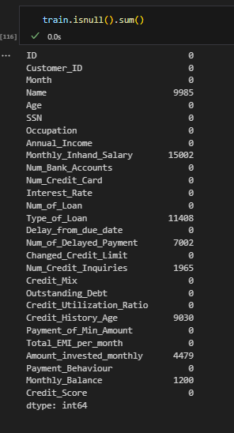
Dataset Description
Train Data : 100,000 instances , 28 columns
Test Data: 50,000, 27 rows
9 categorical, 18 numerical features
(Demographic, Financial, Credit Behavior)
Total Null Values

Slide 4
Import all the necessary library.
Load the data
Perform EDA (Exploratory Data Analysis): null values, duplicate values, filtering, visualization
Feature Encoding : Label Encoding , Ordinal Encoding
Data splitting : Training data and Testing data
Model Selection
Data Preprocessing

Slide 5
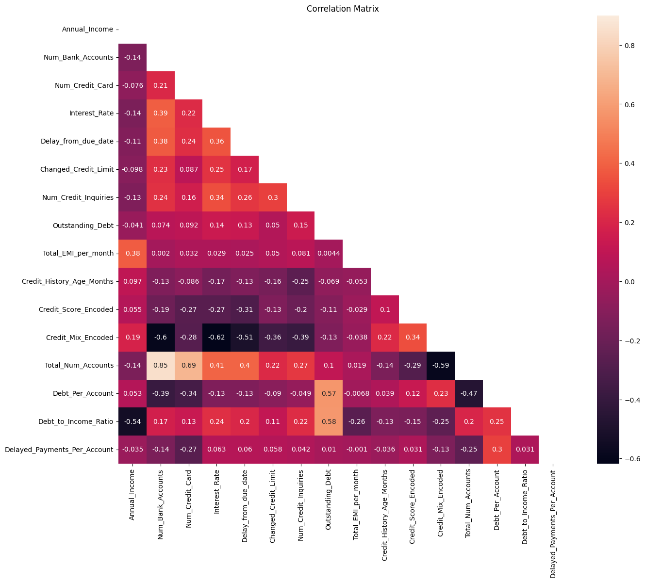
Data Visualization

Slide 6

Logistic Regression
Decision Tree
Model Selection
Random Forest

Slide 7
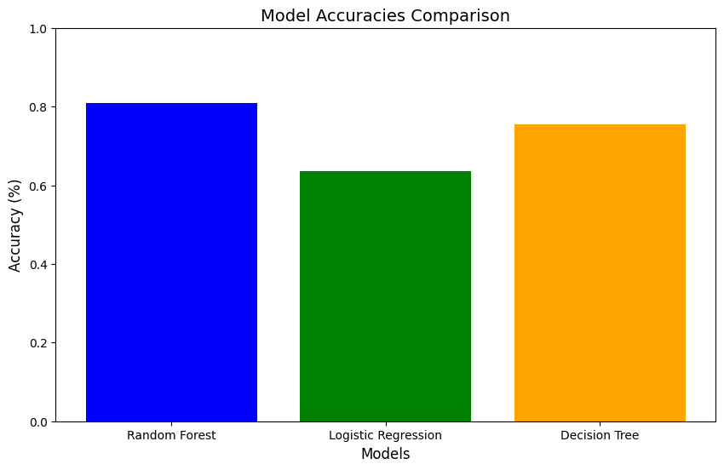
ACCURACY
Logistic Regression : 63%
Decision Tree: 75%
Random Forest: 80%

Slide 8
THANK YOU!

